Slide 1

Choose the appropriate answers:
1. Electricians install…
blueprints
lightning systems
screwdrivers
kneeling

Slide 2

2. Electricians should follow…
manual dexterity
state building regulations
strippers
injuries

Slide 3
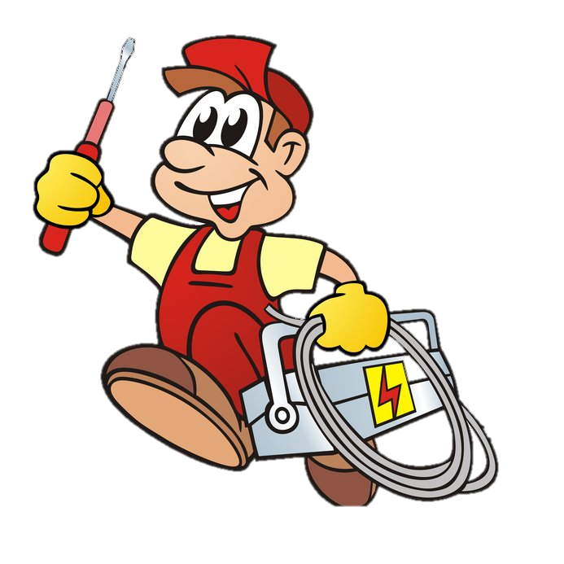
3. Hand and power tools are…
injuries
wiring
wire strippers
safety glasses

Slide 4

Fill in the gap with the right skill or ability.
4.Electricians should work hard all day. This is…
ability to work in a team
manual dexterity
physical fitness
analytical skill

Slide 5

5. Electricians can work …
equipment
regulations
ammeters
full-time

Slide 6
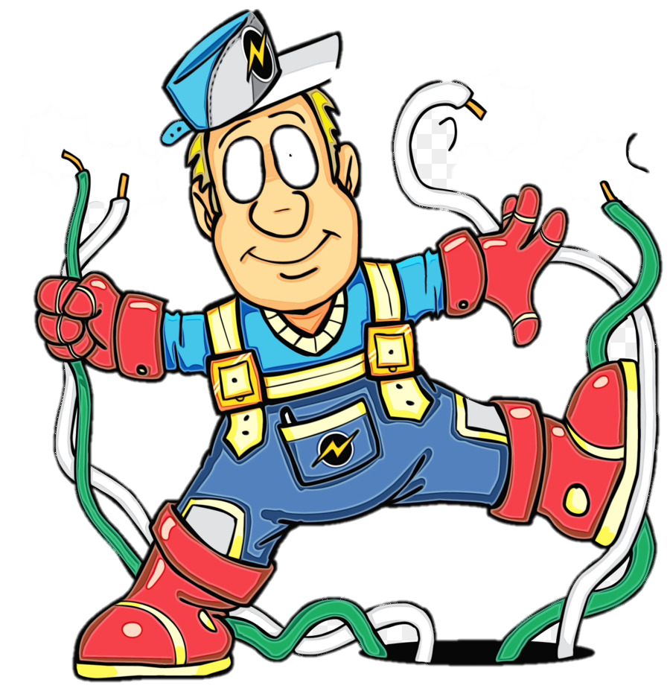
6… don’t belong to minor injuries.
shocks
falls
saws
burns

Slide 7

7. Workers must wear … clothing.
protective
limited
kneeling
minor

Slide 8

8. Measuring devices are …
glasses
ammeters
dexterity
equipment

Slide 9

9. Electricians don’t …
repair dexterity
use measuring devices
read blueprints
maintain wiring

